Slide 1
Computer Hardware
Alden Hilton

Slide 2
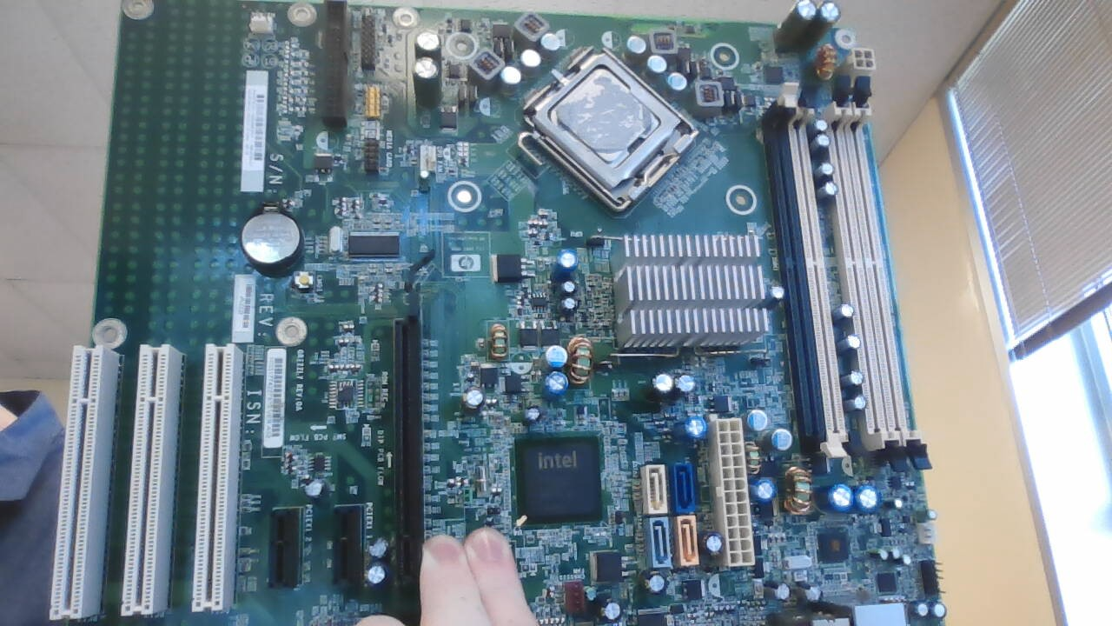
The Motherboard
The Motherboard is the housing area for all the components of a computer.

Slide 3
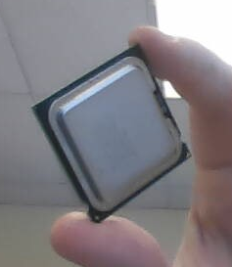
The Processor (CPU)
The CPU of a computer performs all the math actions, processes, and many other various tasks. The CPU receives tasks from RAM and the Hard Drive and stores it in it’s internal cache.

Slide 4
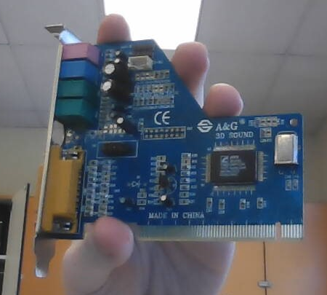
The Sound Card
The Sound Card enhances and allows audio outputted by the computer to be directly connected to stereos, headsets, or other sound devices.

Slide 5
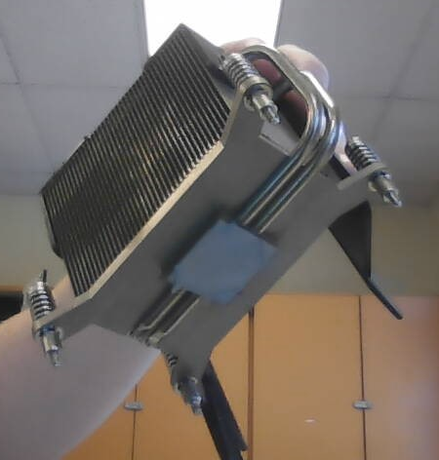
The Heat Sink
The Heat Sink is a fan directly attached to the CPU to prevent the CPU from overheating and causing the computer to malfunction. Thermal paste is a must have before applying onto the CPU to make the most efficient use of the cooling.

Slide 6
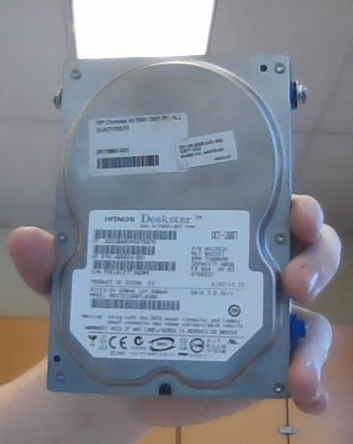
The Hard Drive
All files are stored on this device and can be accessed by the CPU or RAM at any time. Common sizes of these drives range anywhere from 128GB and up.

Slide 7
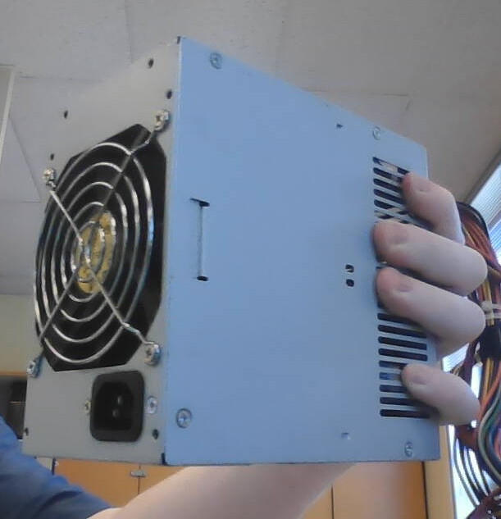
The Power Supply
The Power Supply is the place where all the electricity is converted into a energy source in which then can be distributed to all the components of a PC.

Slide 8
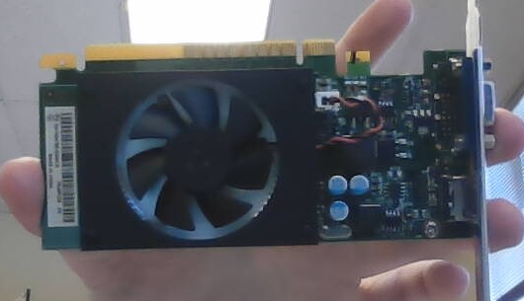
The Graphics Card
The Graphics card renders all of the graphics that are generated by the computer and is then displayed on the monitors connected to it.

Slide 9
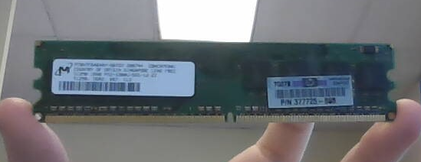
Random Access Memory (RAM)
The RAM is the part of the computer in which data can be received and transferred at any time. This is a temporary, but extremely quick way to transfer data to and from the CPU and Hard Drive.

